Slide 1

Georg Heeg eK
Baroper Str. 337
44227 Dortmund
Germany
Tel: +49-231-97599-0
Fax: +49-231-97599-20
Georg Heeg eK
Wallstraße 22
06366 Köthen
Germany
Tel: +49-3496-214 328
Fax: +49-3496-214 712
Georg Heeg AG
Seestraße 131
8027 Zürich
Switzerland
Tel: +41(848) 43 34 24
Email: georg@heeg.de
http://www.heeg.de

Slide 2
Georg Heeg eK
Baroper Str. 337
44227 Dortmund
Germany
Tel: +49-231-97599-0
Fax: +49-231-97599-20
Georg Heeg eK
Wallstraße 22
06366 Köthen
Germany
Tel: +49-3496-214 328
Fax: +49-3496-214 712
geWEBe/GH-Web
or how shall we call it?
------------------------------------------------------
Design web sites in your own domain language
Georg Heeg AG
Seestraße 131
8027 Zürich
Switzerland
Tel: +41(848) 43 34 24
Email: georg@heeg.de
http://www.heeg.de

Slide 3
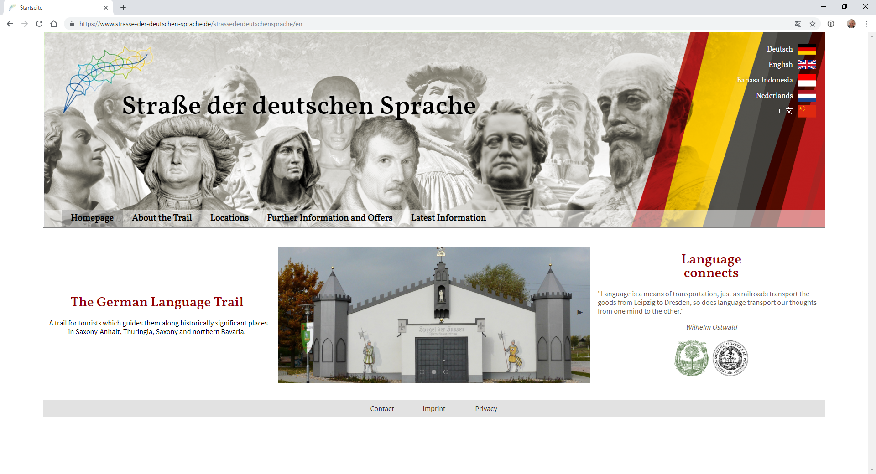
German Language Trail

Slide 4
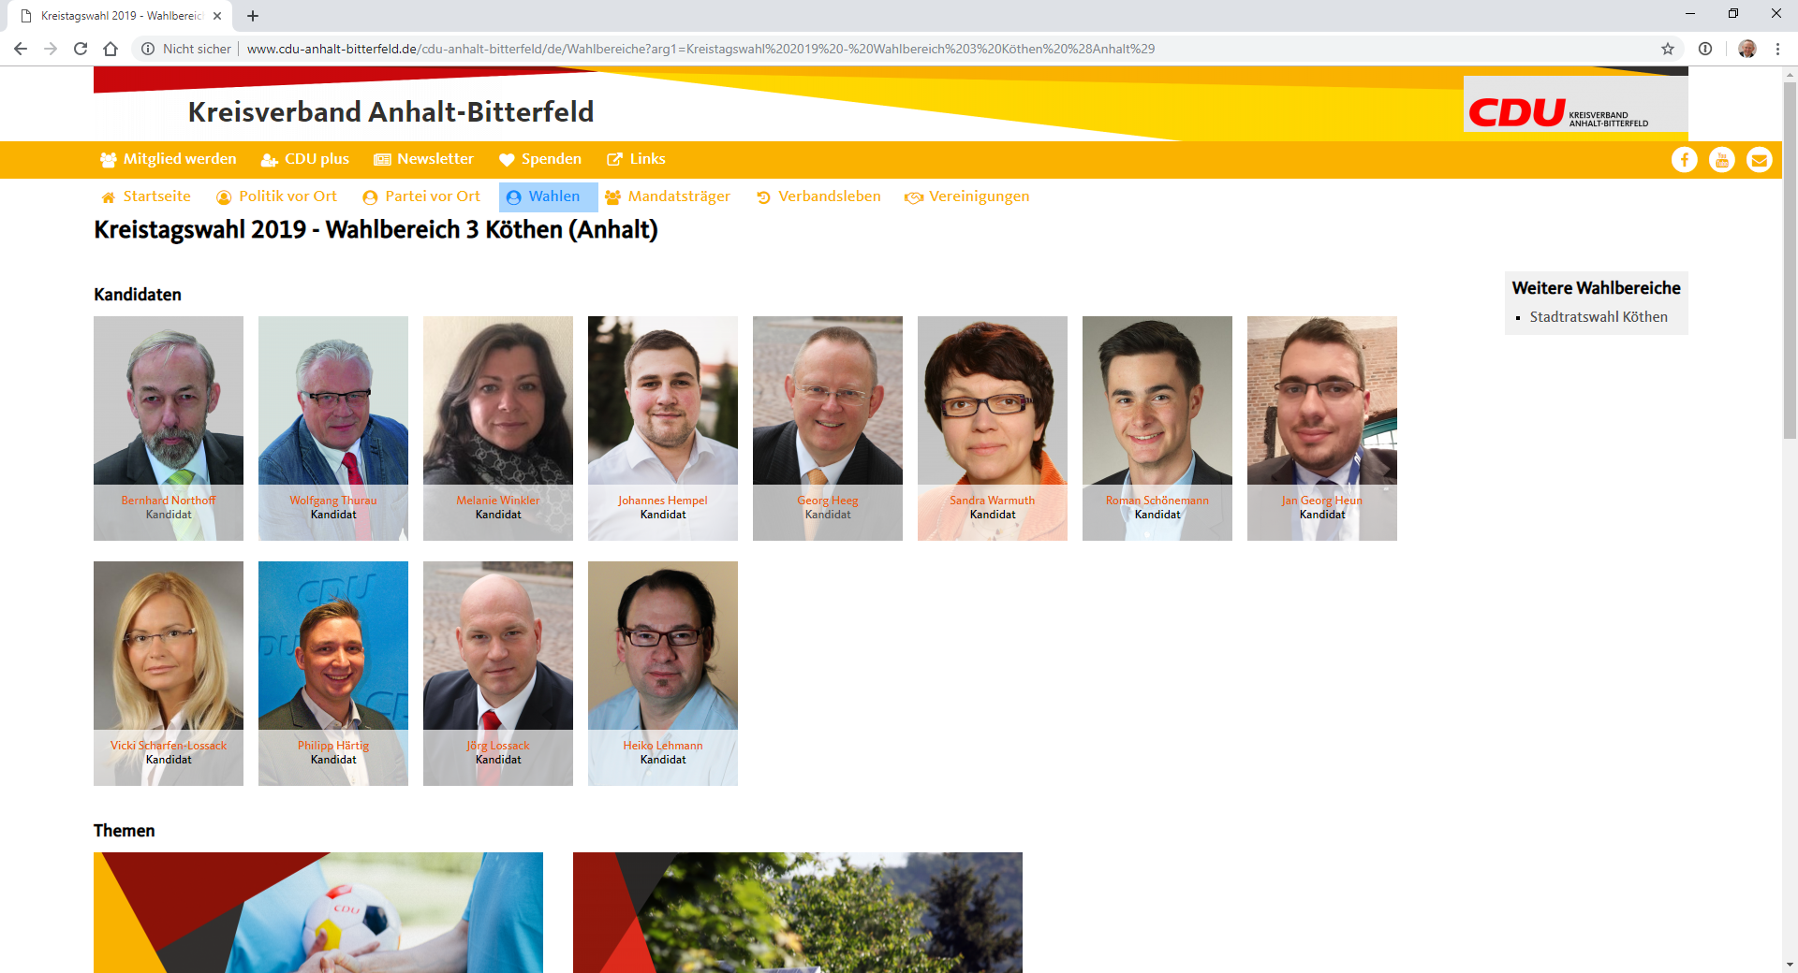
May 26: Municipal Elections

Slide 5
Initial Ideas
Contents (originally in domain language)
Presentation structure
Layout

Slide 6
Contents (originally in domain language)
Split the contents into information entities
Create models for the information entities
Create a folder structure to organize all resources
Create editors for standard use cases entering contents into information entities

Slide 7
Edities
CMSEntity is an instance of a CMSModel, like an object is an instance of a class.

Slide 8
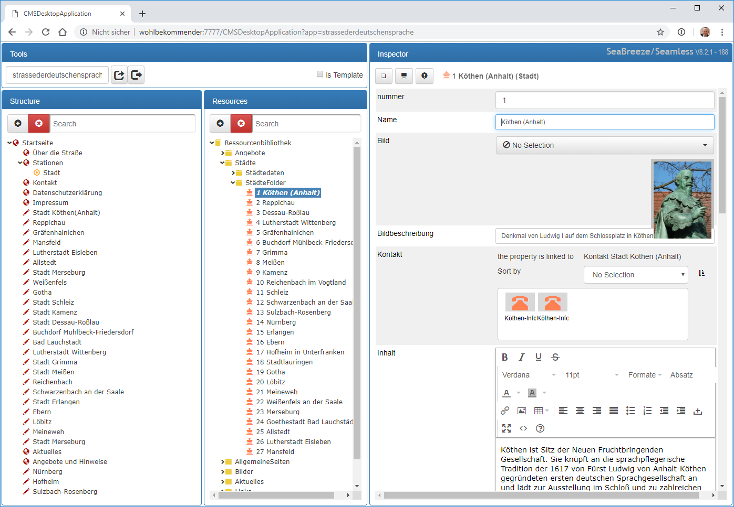

Slide 9
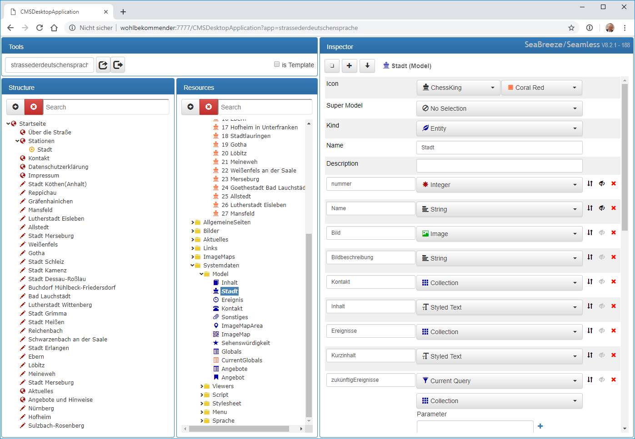

Slide 10
Models
CMSModel acts like a class to describe the structure of a CMSEntity. A model has attributes to describe the instance variables.

Slide 11
Attributes
CMSAttribute describes a typed variable for a CMSModel. It is like an instance variable description for a class.

Slide 12
Primitive Values
CMSPrimitive
  CMSBoolean
  CMSDate
  CMSDateRange
  CMSNumber
    CMSCurrency
    CMSDecimal
    CMSInteger
  CMSString
  CMSStyledText
  CMSText
  CMSTime
  CMSTimestamp

Slide 13
Queries
CMSQuery allows adding computed properties to Models. It uses a Smalltalk Expression to compute result values.

Slide 14
Folders
CMSCollectionEntity represents entities in the system which are a collection and can contain items not only in attributes.

Slide 15
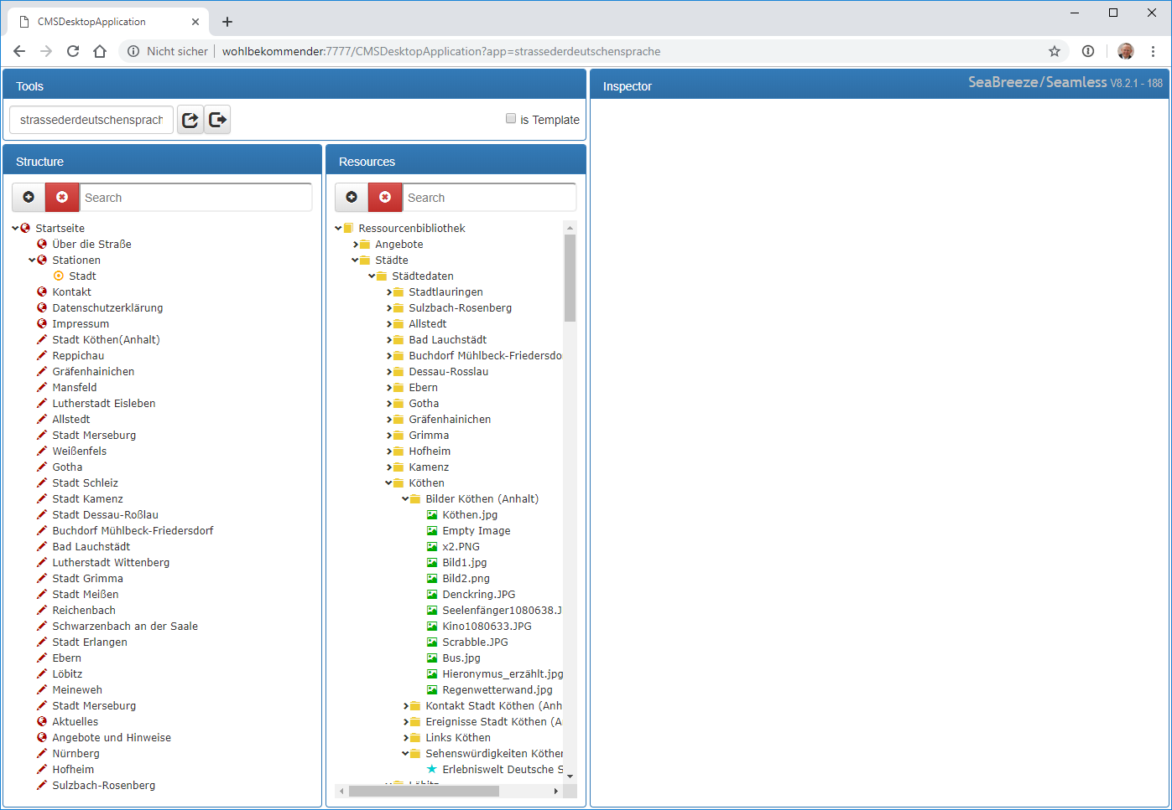

Slide 16
Layout
Have standard viewers ready to present information pieces
Have a way to compose viewers into larger viewers
Have a way to compose viewers into web pages
Add presentation information
  CSS and JavaScript

Slide 17
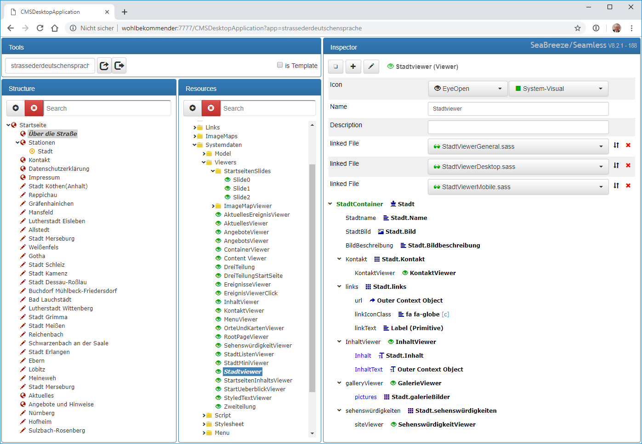

Slide 18
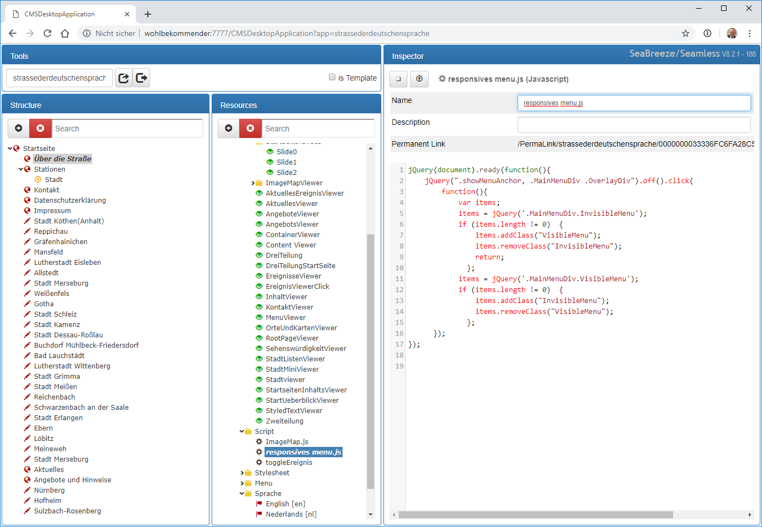

Slide 19
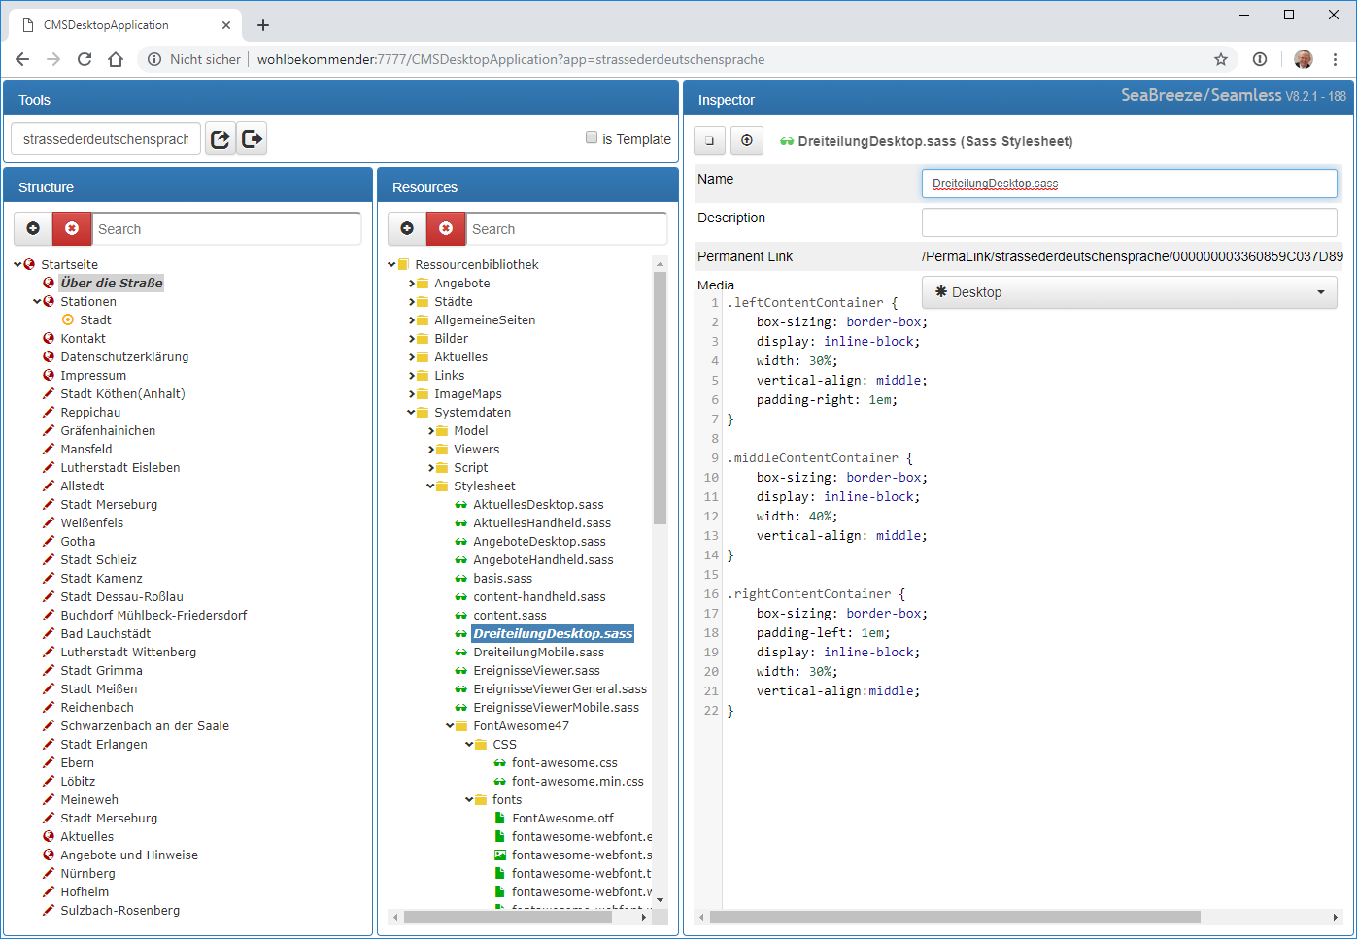

Slide 20
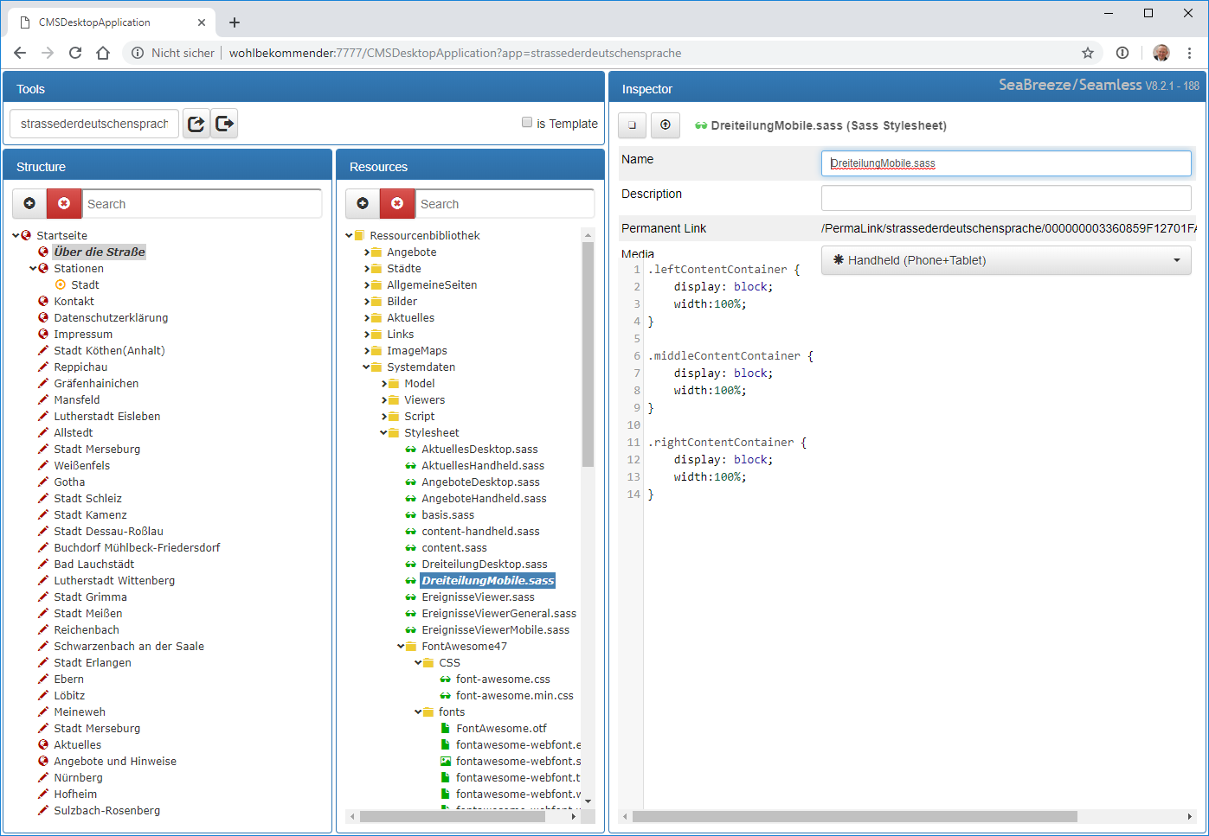

Slide 21
Presentation structure
Map web pages onto entities and their attribute values

Slide 22
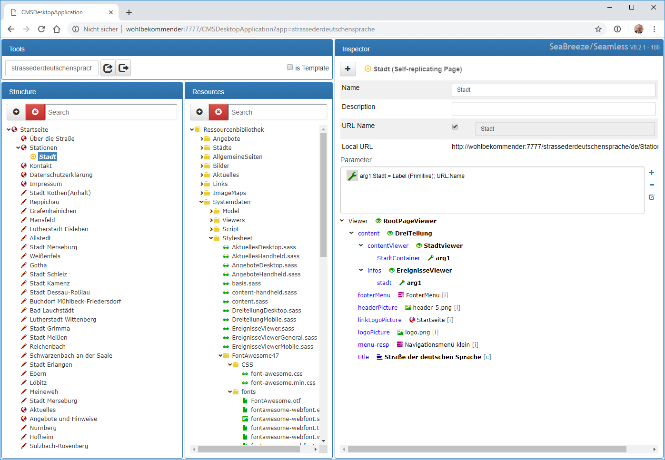

Slide 23
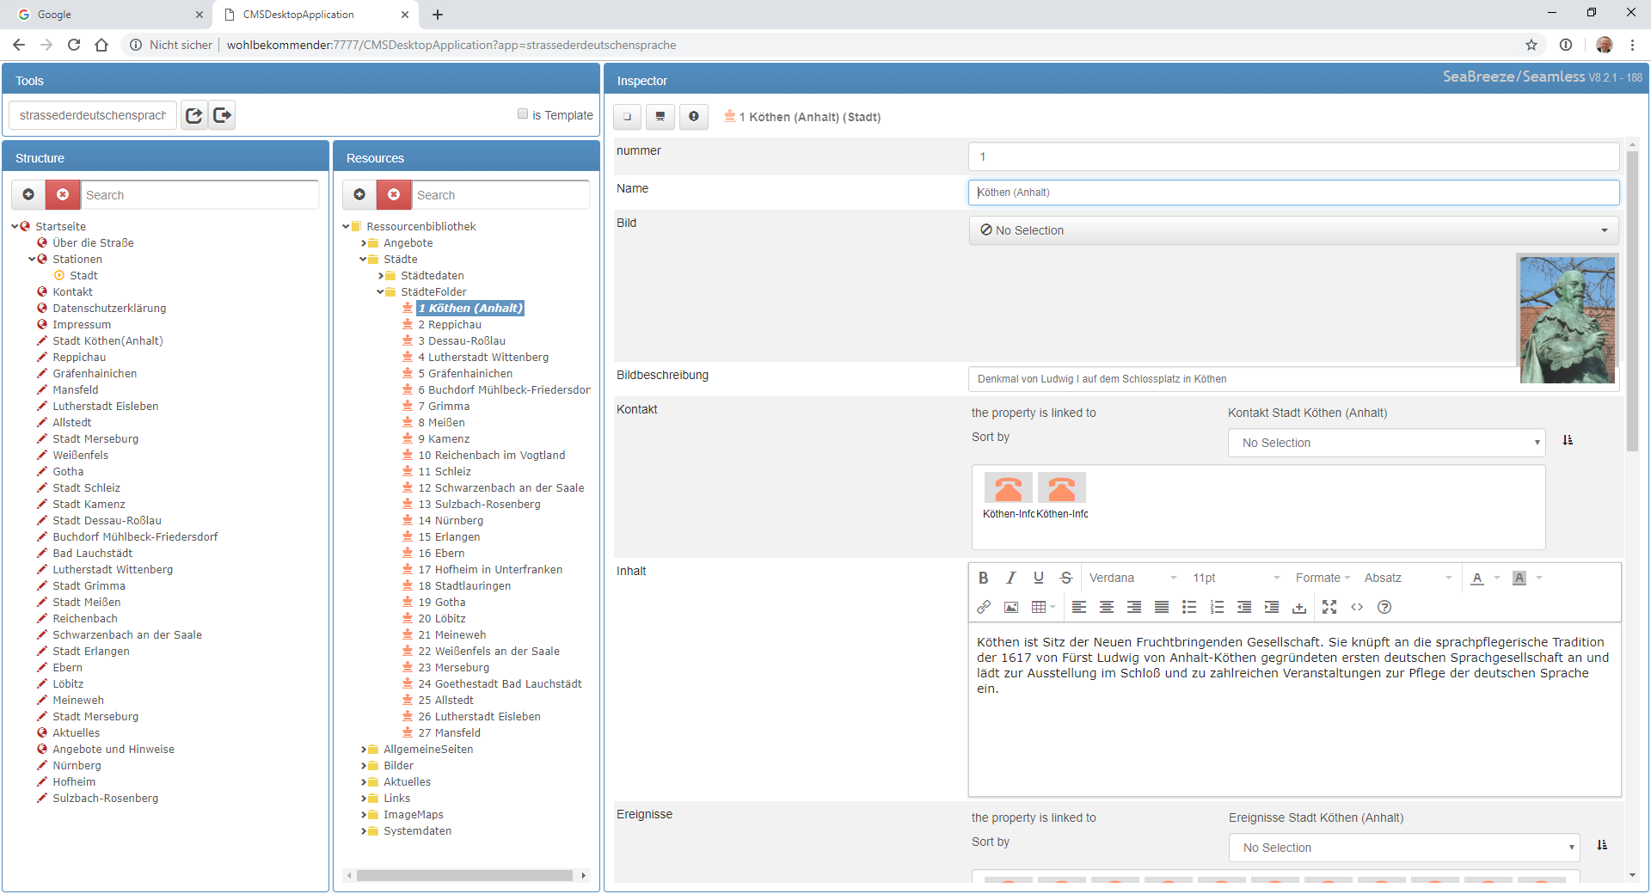
Overall Editor

Slide 24
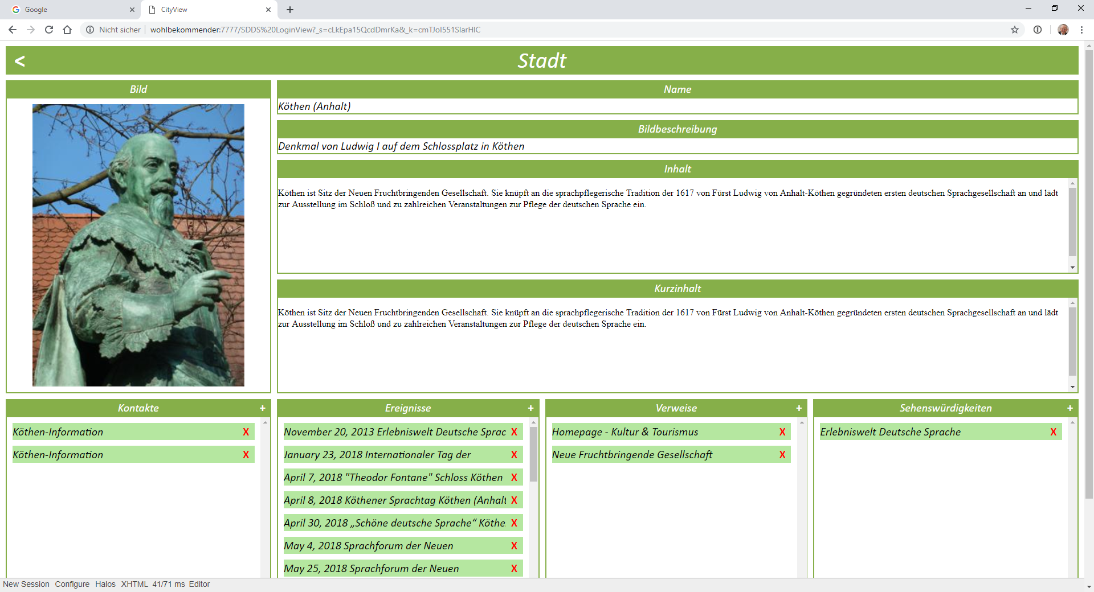
Editor (prototype)

Slide 25
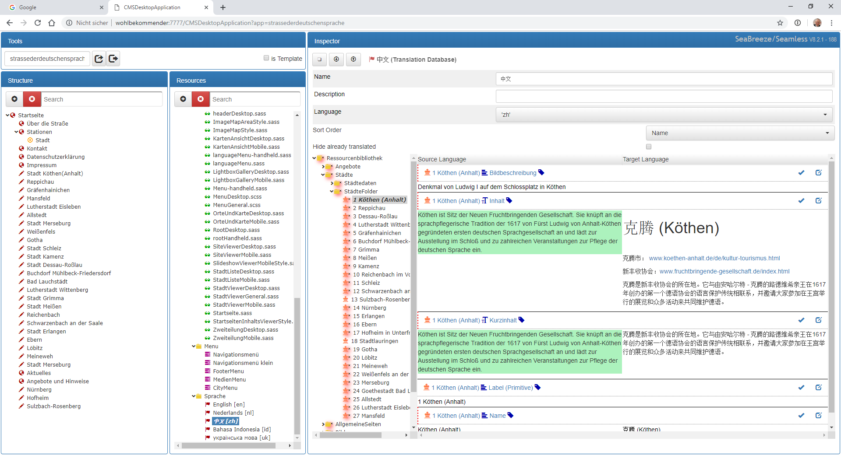
Translating

Slide 26
Architecture
geWEBe
seaBreeze
Seaside
Sioux, L10n, AppeX, Blowfish, ByteOrderMarkSupport ExternalImages, Eurydike, ISAM ToolBox
VisualWoks 32 or 64
Windows or Linux

Slide 27
Effort
Since 7/7/2011
  13,901 hours
  = 1,986 days FTE
  = 9.9 years FTE
Since 1/1/2018
  2,768 hours
  = 395 days FTE
  = 2 years FTE

Slide 28
Georg Heeg eK
Baroper Str. 337
44227 Dortmund
Germany
Tel: +49-231-97599-0
Fax: +49-231-97599-20
Georg Heeg eK
Wallstraße 22
06366 Köthen
Germany
Tel: +49-3496-214 328
Fax: +49-3496-214 712
geWEBe/GH-Web
How shall we call it?
Georg Heeg AG
Seestraße 131
8027 Zürich
Switzerland
Tel: +41(848) 43 34 24
Email: georg@heeg.de
http://www.heeg.de

Slide 29
Georg Heeg eK
Baroper Str. 337
44227 Dortmund
Germany
Tel: +49-231-97599-0
Fax: +49-231-97599-20
Georg Heeg eK
Wallstraße 22
06366 Köthen
Germany
Tel: +49-3496-214 328
Fax: +49-3496-214 712
Georg Heeg AG
Seestraße 131
8027 Zürich
Switzerland
Tel: +41(848) 43 34 24
Email: georg@heeg.de
http://www.heeg.de

